Slide 1
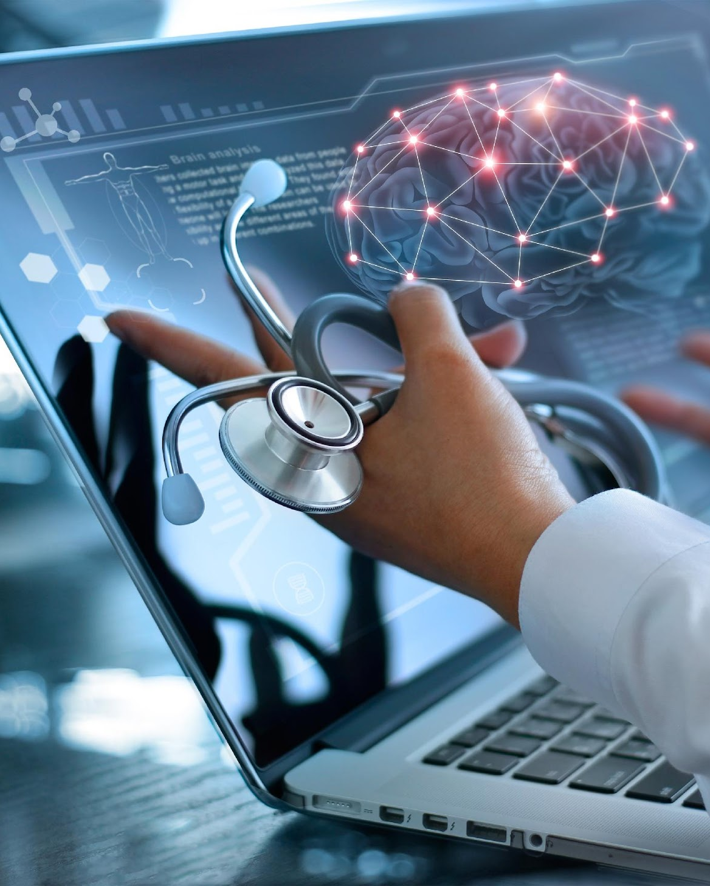
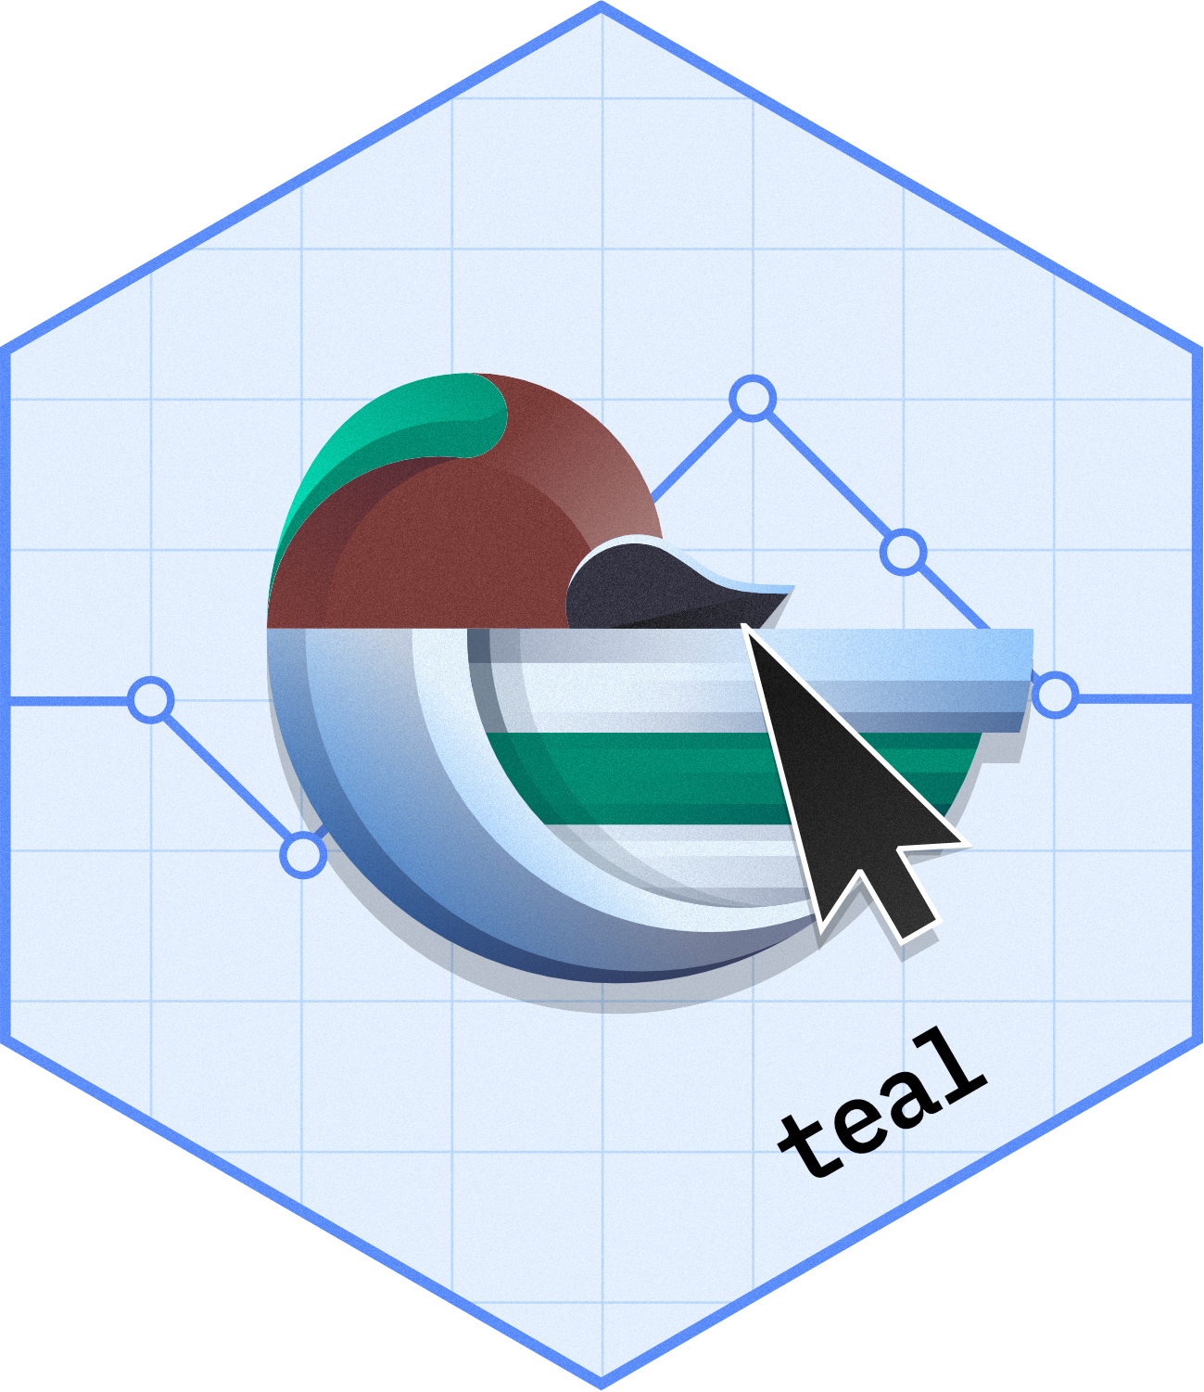
Revolutionize Clinical Trial Data Exploration with teal
R/Pharma - Pharmaverse Friday
Dony Unardi
R in Pharma - Pharmaverse Friday 20 OCT 2023

Slide 2
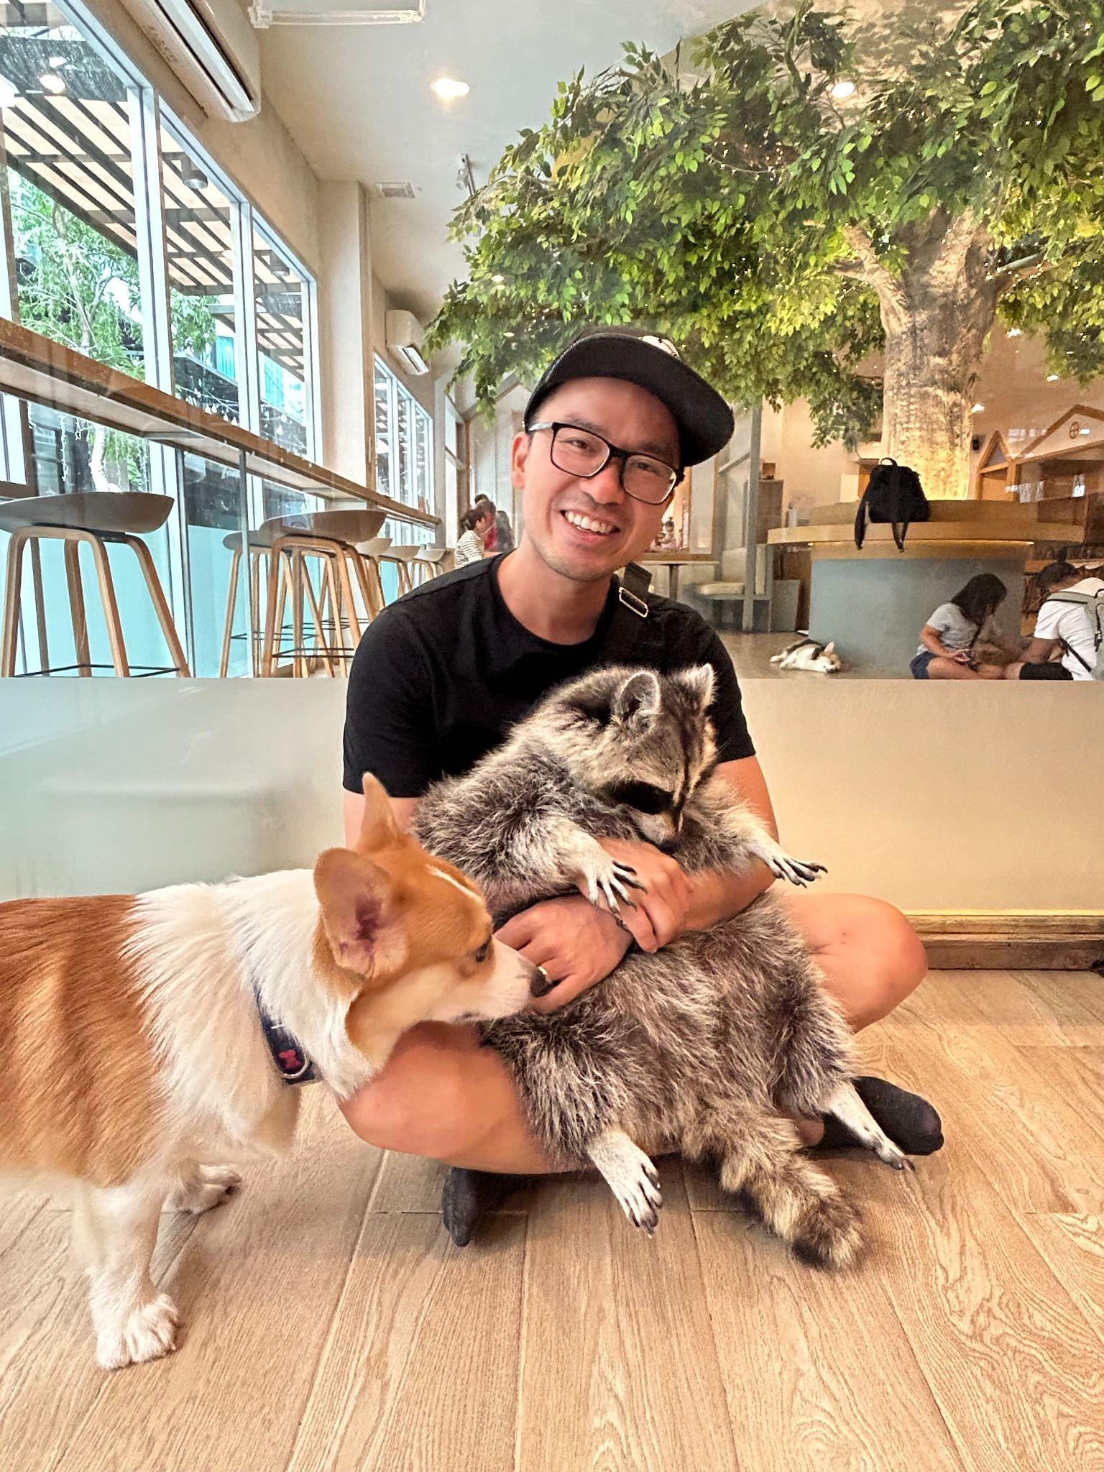
Workshop Instructor: Dony Unardi
Principal Data Scientist at Roche/Genentech
Engineering Team Lead for teal
Prior roles:
SAS Programmer
Full Stack Web Developer (independent)
MS SQL Server Developer
When I am not doing R:
Travel
Animals
Culinary
Soccer

Slide 3
I’d like to learn about you!
Slido links:
https://app.sli.do/event/mfmX8ueV7Vq8fuzryPSzHP

Slide 4
Today’s Goal
To learn about teal framework and teal modules
Hands-on exercises
Create a very simple teal app
Create a teal app with non-cdisc data
Create a teal app with cdisc data
Learn about teal’s filters
Explore other teal features from UI
Have fun!

Slide 5
Expectation
Be respectful, follow the Terms and Conditions of R/Pharma
https://rinpharma.com/terms/
Get connected!
Join pharmaverse slack workspace and join #teal channel
🐛? Or new feature request?
Let us know on GitHub: https://github.com/insightsengineering/teal/issues

Slide 6
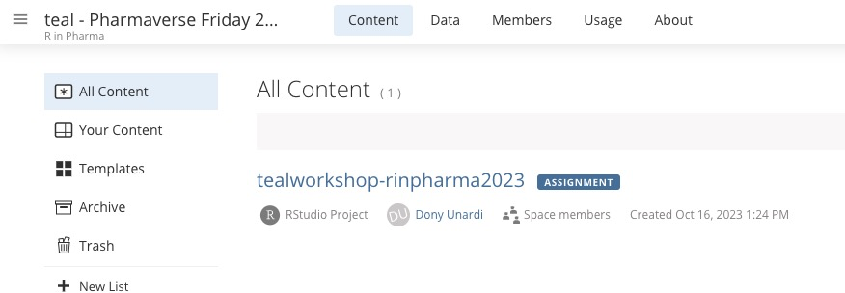
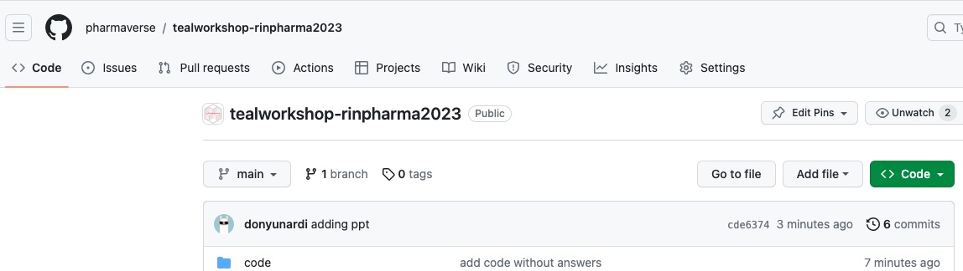
Environment & Materials
We’ll be working in Posit Cloud
teal frameworks and modules are installed for you
All materials are in Github

Slide 7

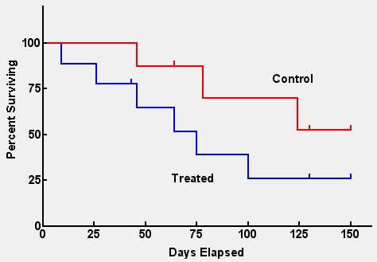
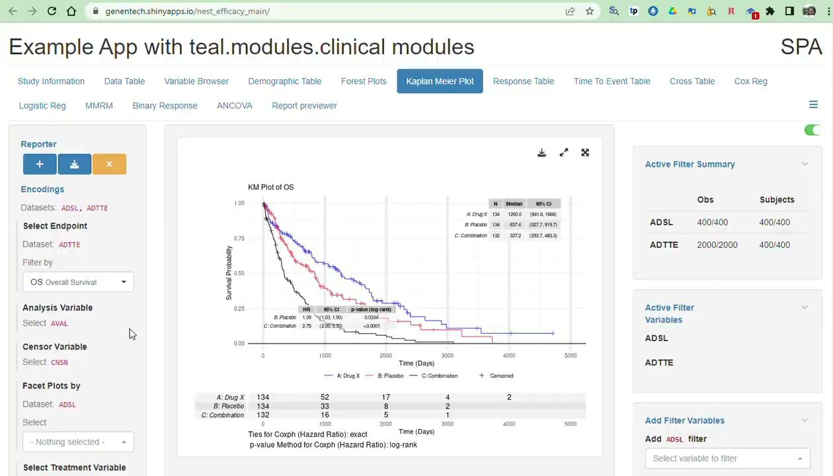
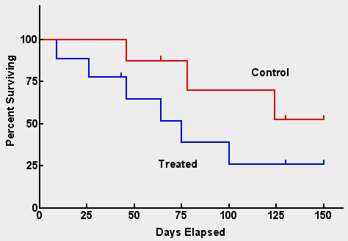
Improve efficiency in the way we work
Analyzing clinical trial data requires multiple ways of presenting and interacting with our data
Kaplan Meier Plot
Protocol: 1111 Snapshot: 222 Cutoff date: Jan 2, 2016
Per-SAP static output on OS
Additional Footnotes
Program:<path>/kmplot.R
Output: <path>/kmplot_ITT.pdf 1 of 3
Ad-hoc analysis on PFS
Ad-hoc analysis on PFS in subpopulation
Building scalable exploratory R-shiny web-apps

Slide 8

What is {teal}?
A Rshiny-based interactive data exploration framework
Modularized and standardized building blocks
Collection of specialized R packages
Streamlines creation of web-apps that offers:
Dynamic filtering facility
Code reproducibility
Reporting engine
Many data summarization and visualizations

Slide 9
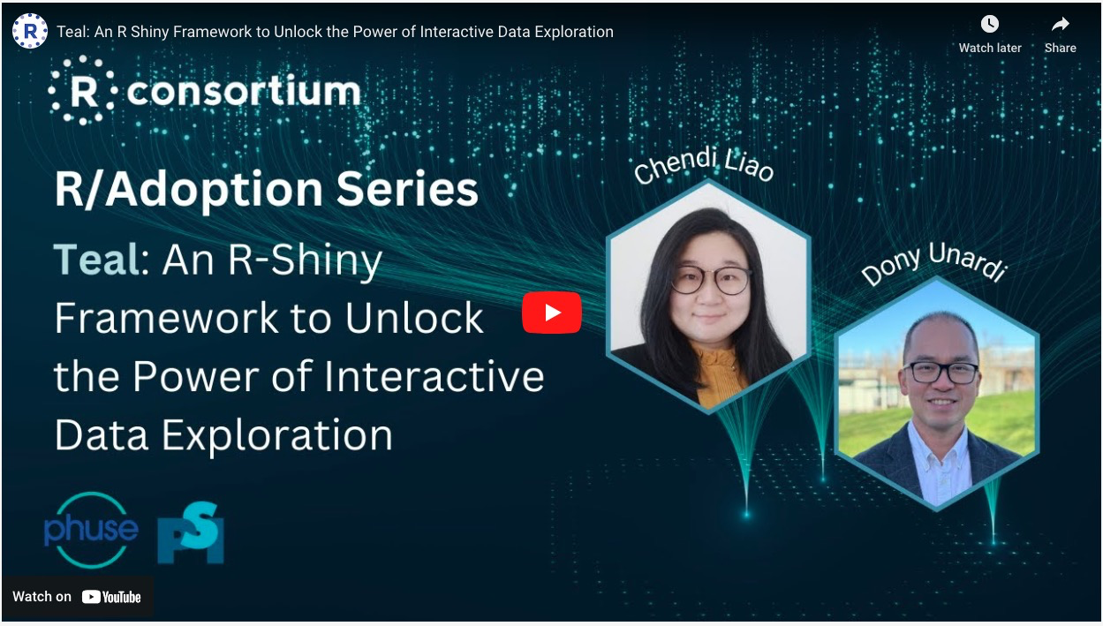
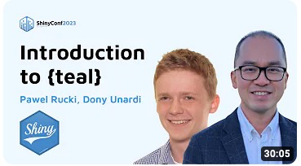
`teal` in YT!
Watch our past teal presentations in YT
Teal: An R Shiny Framework to Unlock the Power of Interactive Data Exploration
Introduction to {teal}

Slide 10
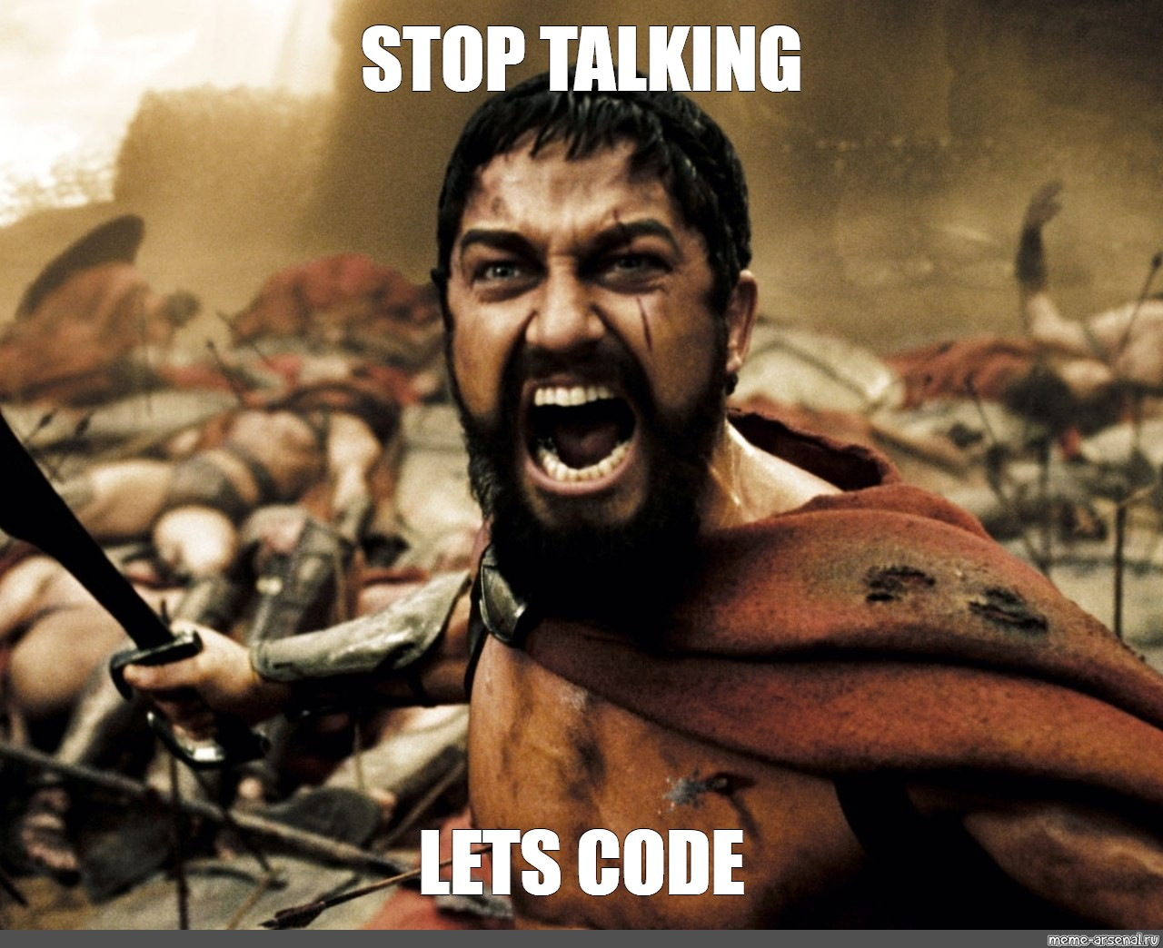

Slide 11
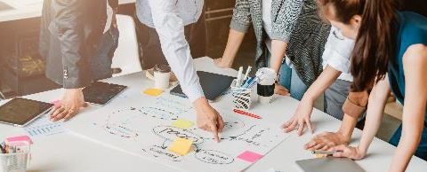
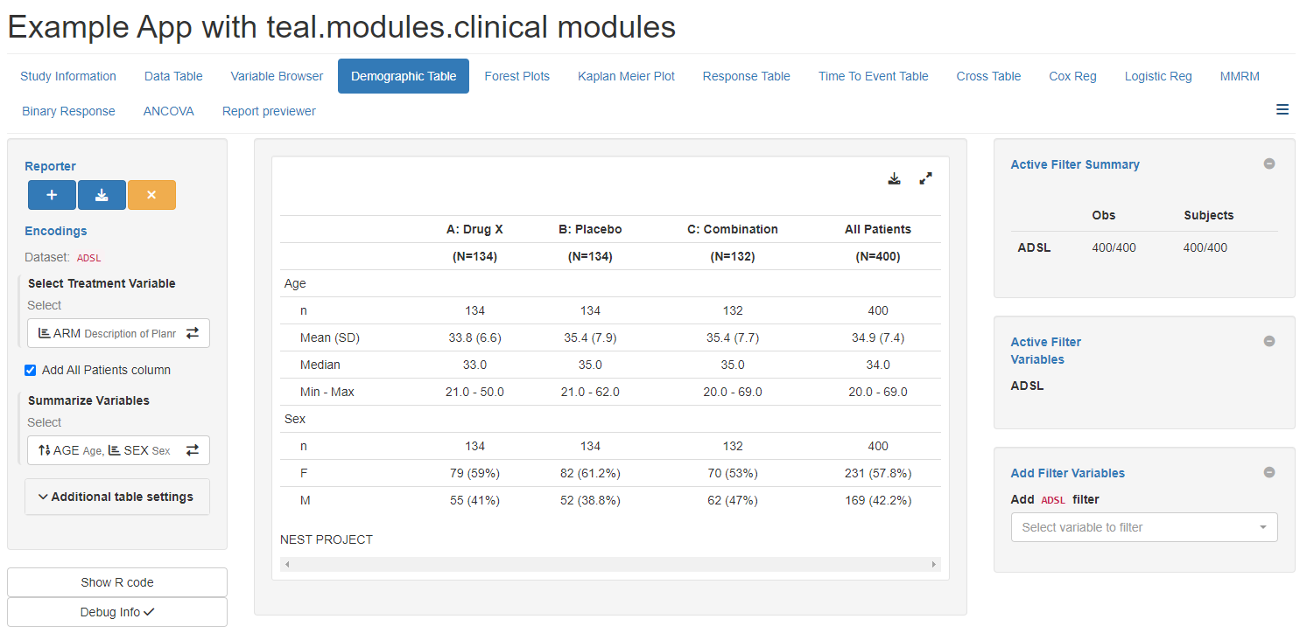

{teal} Universe Products Map
teal Framework
teal Modules
Calculations
teal
teal.modules.general
teal.modules.clinical
tern
teal.gallery
teal.reporter
teal.widgets
teal.osprey
osprey
teal.slice
teal.data
teal.transform
teal.goshawk
goshawk
teal.logger
teal.code
teal.modules.hermes
hermes

Slide 12

Demo Apps via {teal} Gallery
https://insightsengineering.github.io/teal.gallery/demo.html
Links on shinyapps.io
APP_NAME
Exploratory analysis on general data frames
“exploratory”
Safety analysis on clinical trial data
“safety”
Efficacy analysis on clinical trial data
“efficacy”
Notes:
Open teal.gallery
Show Snapshot Manager
Show Reproducibility
Show Blueprint in repo

Slide 13

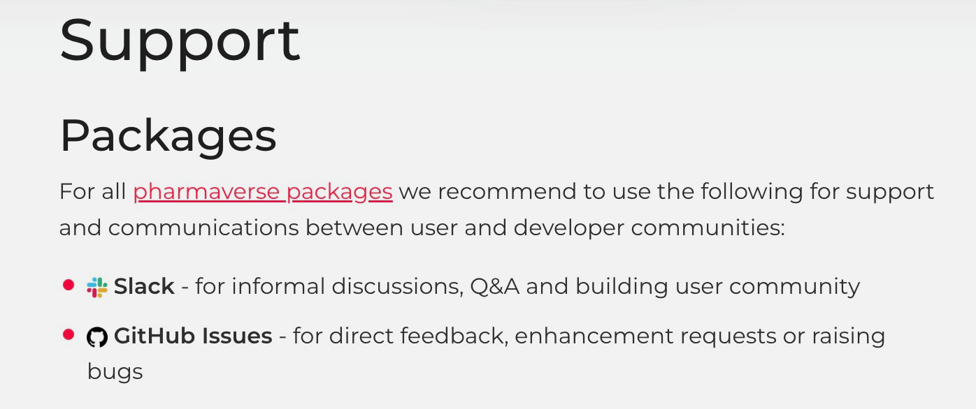

Additional Resources
{teal} is part of pharmaverse: https://pharmaverse.org/
More information about support: https://pharmaverse.org/support/
Slack channel #teal under pharmaverse workspace
Upcoming course on Coursera “Hands On Clinical Reporting Using R” in Q4 2023

Slide 14
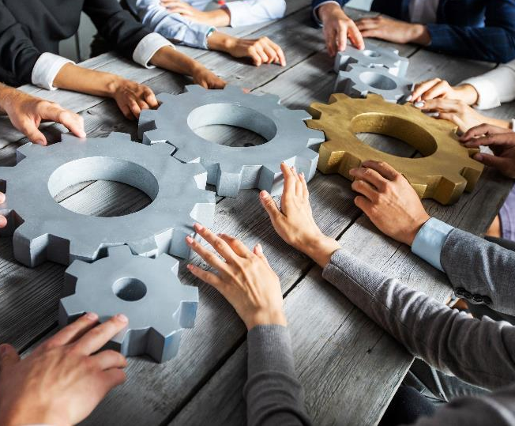




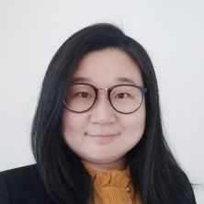
Collaborating on {teal}
We are looking for collaborators to develop this framework further!
If you’re an individual, please contribute on GitHub and join us via pharmaverse Slack #teal channel
If you’re an organization wanting to adopt {teal}
and co-develop, please get in touch with our Product Owner chendi.liao@roche.com
Notes:
Keep for PHUSE

